Slide 1
Module 3
Managing Microsoft Exchange Server and recipient objects by using Exchange Management Shell
Notes:
Presentation: 60 minutes
Demonstration: 40 minutes
Lab: 70 minutes After completing this module, students will be able to:
Explain the Exchange Management Shell cmdlets that you can use to configure and manage Microsoft Exchange Server 2016.
Manage Exchange Server and recipient objects by using the Exchange Management Shell.
Manage Exchange Server and recipient objects by using the Exchange Management Shell scripts.
Required Materials
To teach this module, you need the Microsoft PowerPoint file 20345-1A_04.pptx.
Preparation Tasks
To prepare for this module, you should:
Read all of this module’s materials.
Practice performing the demonstrations and labs.
Work through the Module Review and Takeaways section to determine how you will use the information to reinforce student learning and promote knowledge transfer to on-the-job performance.
As you prepare for this class, it is imperative that you complete the labs yourself. This gives you an understanding of how the labs work and the concepts that each covers, so that you can provide meaningful hints to students who might have issues. Furthermore, it will help guide your lecture to ensure that you discuss the concepts that the labs cover.
20345-1A
4: Managing Microsoft Exchange Server 2016 and recipient objects by using Exchange Management Shell

Slide 2
Module Overview
Overview of the Exchange Management Shell Managing Exchange Server by using Exchange Management Shell Managing Exchange Server by using Exchange Management Shell scripts
Notes:
20345-1A
4: Managing Microsoft Exchange Server 2016 and recipient objects by using Exchange Management Shell

Slide 3
Lesson 1: Overview of the Exchange Management Shell
Windows PowerShell ISE Connecting to Exchange Server and Exchange Online by using Windows PowerShell Overview of Exchange Management Shell recipient cmdlets Options for formatting Windows PowerShell output Using Windows PowerShell pipelining Using Windows PowerShell variables and loops Using filters in Windows PowerShell commands Demonstration: Managing Exchange recipients by using the Exchange Management Shell
Notes:
Question
The Exchange Server 2016 management tools are required to use the Windows PowerShell cmdlets for Exchange Server.
( )False
( )True
Answer
(√)False
Feedback
No. Installing the management tools will install the Exchange Management Shell. However, you still can import the Windows PowerShell cmdlets for Exchange Server by establishing a remote Windows PowerShell session to your Exchange Server or Exchange Online.
Question
Which Windows PowerShell cmdlets should you pipe output to when you want to return specified properties of an object?
( )Option 1: Where-Object
( )Option 2: Select-Object
( )Option 3: Measure-Object
( )Option 4: Sort-Object
( )Option 5: Format-List
Answer
(√ )Option 2: Select-Object
(√ )Option 5: Format-List
20345-1A
4: Managing Microsoft Exchange Server 2016 and recipient objects by using Exchange Management Shell
(More notes on the next slide)

Slide 4
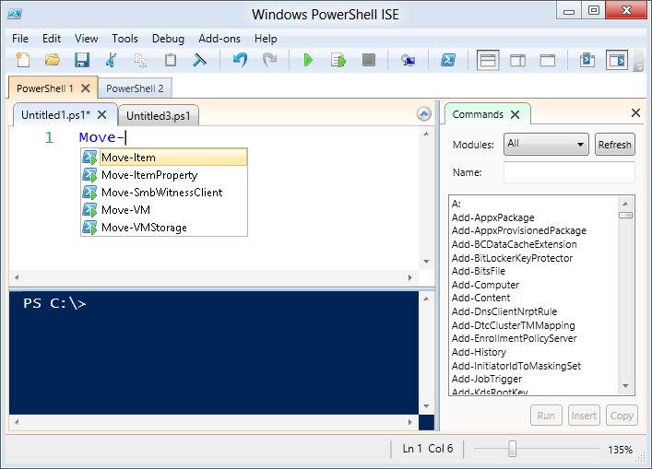
Windows PowerShell ISE
You can use the Windows PowerShell ISE to run commands and to design, write, test, and debug scripts in a GUI
Windows PowerShell tabs
IntelliSense
suggestions
The script
pane
The console
pane
The add-in tools pane
Notes:
The Windows PowerShell Integrated Scripting Environment (ISE) is a graphical tool that makes it easier to work with Windows PowerShell scripts. Discuss the lead-in sentence at the top of the slide, and emphasize that the ISE is designed for both novice and advanced users.
Additionally, point out the following beneficial features of the Windows PowerShell ISE, including:
Microsoft IntelliSense, which provides inline help for cmdlets, parameters, parameter values, and file paths as you type in the Script or Console pane.
Syntax coloring, which improves contrast and readability, and helps minimize typing errors.
Multiline editing that allows you to create scripts and functions easily.
The ability to copy and paste code snippets from other sources, such as the Internet.
Command completion, which includes tooltip help. This typically saves time for both novice and experienced administrators.
If time allows, demonstrate the basic features of Windows PowerShell ISE:
Start virtual machines LON-DC1 and LON-EX1, and then sign in to LON-EX1 with the user name Adatum\Administrator and the password Pa$$w0rd.
Open the Windows PowerShell ISE as an administrator, and then refer to the following demonstration script:
C:\Labfiles\Mod04\Democode\Lesson01Demo-ISEFeatures.ps1
20345-1A
4: Managing Microsoft Exchange Server 2016 and recipient objects by using Exchange Management Shell

Slide 5
Connecting to Exchange Server and Exchange Online by using Windows PowerShell
Connecting to a local Exchange Server
If management tools are installed on the system, start Exchange Management Shell
Connecting to a remote Exchange Server (on-premises)
If management tools are not available, import a remote PSSession object into your existing Windows PowerShell or Windows PowerShell ISE session
Connecting to Exchange Online
It is similar to connecting to a remote on-premises Exchange Server, with a few key differences
Notes:
Note: This topic has one additional slide.
When discussing remote Windows PowerShell connections to Exchange Server and Exchange Online, point out the differences between the two code samples in the student manual, namely the different ConnectionUri and the authentication parameters. On-premises servers belong to an Active Directory Domain Services (AD DS) domain, Kerberos is the recommended authentication type. You would not use basic authentication in this scenario, especially over an unsecured (HTTP) connection. Exchange Online only supports basic authentication, and requires the AllowRedirection parameter to support organizations that use single sign-on (SSO) for authentication.
20345-1A
4: Managing Microsoft Exchange Server 2016 and recipient objects by using Exchange Management Shell

Slide 6
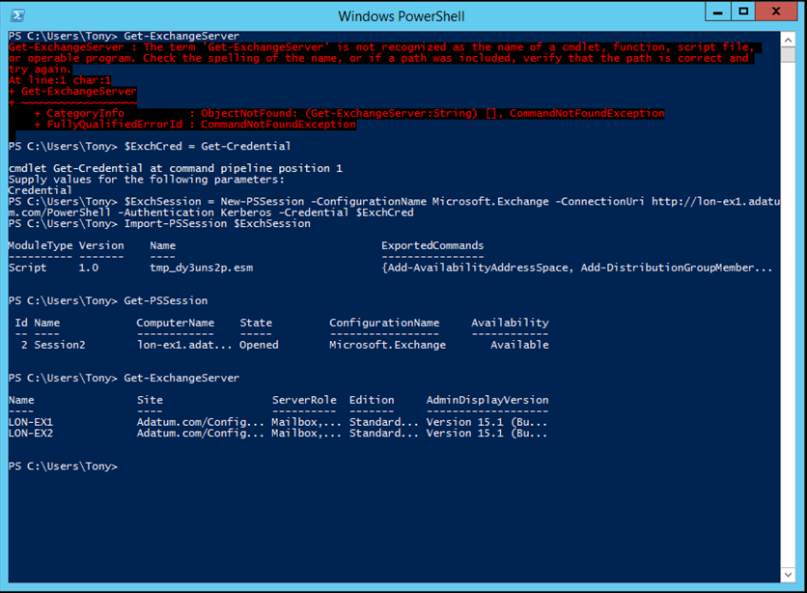
Connecting to a remote Exchange Server (on-premises)
1
2
3
Notes:
Referring back to the section on connecting to a remote Exchange Server (on-premises), use the screenshot on the slide to show the process of importing a remote PSSession object into a regular Windows PowerShell session.
The first section shows that running Get-ExchangeServer returns an error about the name of the cmdlet being unrecognized.
The second section shows the results of running the following commands:
$ExchCred = Get-Credential
$ExchSession = New-PSSession –ConfigurationName Microsoft.Exchange – ConnectionUri http://lon-ex1.adatum.com/PowerShell/ -Authentication Kerberos – Credential $ExchCred
Import-PSSession $ExchSession
The second section also shows that running the Get-PSSession cmdlet displays an open and available connection to LON-EX1
The last section shows that Get-ExchangeServer is now a recognized cmdlet and produces output when it is run.
20345-1A
4: Managing Microsoft Exchange Server 2016 and recipient objects by using Exchange Management Shell

Slide 7
Overview of Exchange Management Shell recipient cmdlets
Cmdlet Noun | Cmdlet Name
Mailbox | New-Mailbox Enable-Mailbox Get-Mailbox Set-Mailbox Disable-Mailbox Remove-Mailbox
DistributionGroup | New-DistributionGroup Enable-DistributionGroup Get-DistributionGroup Set-DistributionGroup Disable-DistributionGroup Remove-DistributionGroup
DistributionGroupMember | Add-DistributionGroupMember Remove-DistributionGroupMember Update-DistributionGroupMember
Notes:
Discuss the standardized naming for Exchange Management Shell cmdlets. Describe when you would use New-Mailbox versus Enable-Mailbox. If you have time, show how to use Get-Command to find cmdlets based on either the verb or the noun.
20345-1A
4: Managing Microsoft Exchange Server 2016 and recipient objects by using Exchange Management Shell

Slide 8
Options for formatting Windows PowerShell output
Cmdlets for formatting output:
Format-Wide (FW)
Format-Table (FT)
Format-List (FL)
Format-Custom (FC)
Cmdlets for manipulating output:
Measure-Object (measure)
Sort-Object (sort)
Select-Object (select)
Where-Object (where)
Notes:
Discuss the cmdlets that you can use for formatting and manipulation, and explain when you might want to use them.
Explain or demonstrate the format for each output type:
Format-Wide
Format-Table
Format-List
Format-Custom
Explain or demonstrate the following cmdlets:
Measure-Object
Sort-Object
Select-Object
Where-Object
If time permits, show how each of the formatting options works, by using these steps:
Start virtual machines LON-DC1 and LON-EX1, and then sign in to LON-EX1 with the user name Adatum\Administrator and the password Pa$$w0rd.
Open the Windows PowerShell ISE as an administrator, and then open the following demonstration script:
C:\Labfiles\Mod04\Democode\Lesson01Demo-Formatting.ps1.
20345-1A
4: Managing Microsoft Exchange Server 2016 and recipient objects by using Exchange Management Shell

Slide 9
Using Windows PowerShell pipelining
The pipeline connects the output from one cmdlet to the input of another cmdlet
The combination of the first cmdlet, the pipe operator ( | ), and the second cmdlet makes a pipeline
Also referred to as piping
The special variable $_ allows you to reference the current object in the pipeline
Get-User –RecipientTypeDetails User | Enable- Mailbox
Notes:
Discuss how to pass information between cmdlets. Discuss the process of using Get-User to return a list of all users in the domain, and then to pipe the results to the Enable-Mailbox cmdlet. Mention that when you use the Get-User cmdlet, the students need to specify the RecipientTypeDetails parameter so that only user accounts that are not mail-enabled are returned. This is because you typically do not need to enable mailboxes for the users who already have one. Explain how to access an object and its properties by using the special variable, $_.
20345-1A
4: Managing Microsoft Exchange Server 2016 and recipient objects by using Exchange Management Shell

Slide 10
Using Windows PowerShell variables and loops
foreach ($Mailbox in $Mailboxes){
$Mailbox | Set-Mailbox}
if ($User.Office -eq “London”) {
Enable-Mailbox $User –Database “London Database 1”}
while ($i -le 5) {New-MailboxDatabase –Server LON-EX1 –Name “DB$i”; $i++}
for ($i=1; $i -le 5; $i++) {New-MailboxDatabase –Server LON-EX1 –Name “DB$i”}
Notes:
Discuss each of the types of loops and conditions, and Boolean conditions and how you can use them in many loops. Additionally, point out that in some cases, you can use a pipeline rather than a foreach loop.
If time permits, demonstrate basic script examples for each of the loops and conditions:
Start virtual machines LON-DC1 and LON-EX1, and then sign in to LON-EX1 with the user name Adatum\Administrator and the password Pa$$w0rd.
Open the Windows PowerShell ISE as an administrator, and then refer to the following demonstration scripts:
C:\Labfiles\Mod04\Democode\Lesson01Demo-UsingIfStatements.ps1
C:\Labfiles\Mod04\Democode\Lesson01Demo-UsingSwitchStatements.ps1
C:\Labfiles\Mod04\Democode\Lesson01Demo-UsingLoops.ps1
20345-1A
4: Managing Microsoft Exchange Server 2016 and recipient objects by using Exchange Management Shell

Slide 11
Using filters in Windows PowerShell commands
Filtering with the Where-Object cmdlet:
Use to filter the output of any cmdlet
Can support multiple comparisons in the where clause
Filtering with the Select-Object cmdlet:
Use to filter at a property level
Can also filter objects by using the –First, -Last, and –Unique parameters
Filtering with the –Filter parameter:
Available on specific Exchange Management Shell cmdlets such as Get-Mailbox
Limited set of filterable properties
More efficient
Notes:
Discuss the different methods that you can use to filter data in Windows PowerShell and the situations in which the students might use each of the different methods.
If time permits, demonstrate the basic script examples for each of the filters:
Start virtual machines LON-DC1 and LON-EX1, and then sign in to LON-EX1 with the user name Adatum\Administrator and the password Pa$$w0rd.
Open the Windows PowerShell ISE as an administrator, and then refer to the following demonstration script:
C:\Labfiles\Mod04\Democode\Lesson01Demo-Filtering.ps1
20345-1A
4: Managing Microsoft Exchange Server 2016 and recipient objects by using Exchange Management Shell

Slide 12
Demonstration: Managing Exchange recipients by using the Exchange Management Shell
In this demonstration, you will see how to use Windows PowerShell to manage Exchange Server recipients
Notes:
Leave the virtual machines running after you complete the demonstration.
Preparation Steps
Start virtual machines 20345-1A-LON-DC1 and 20345-1A-LON-EX1, and then sign in to LON-EX1 with the user name Adatum\Administrator and the password Pa$$w0rd.
Demonstration Steps
On LON-EX1, go to the Start screen.
On the Start screen, type Windows PowerShell ISE, right-click Windows PowerShell ISE, and then click Run as administrator.
Click File, and then click Open.
Go to C:\Labfiles\Mod04\Democode.
Select Lesson01Demo-ManagingRecipients.ps1, and then click Open.
Follow the script’s instructions to complete the demonstration.
Note: If at any time, you are prompted Do you want to run Update-Help? Click No.
If at any time, you are prompted to enter a password, use Pa$$w0rd.
20345-1A
4: Managing Microsoft Exchange Server 2016 and recipient objects by using Exchange Management Shell

Slide 13
Lesson 2: Managing Exchange Server by using Exchange Management Shell
Overview of Exchange Management Shell server-configuration cmdlets Configuring Exchange Server by using the Exchange Management Shell Demonstration: Managing server configuration by using Exchange Management Shell Overview of Exchange Management Shell test cmdlets Monitoring Exchange Servers by using Exchange Management Shell Demonstration: Monitoring Exchange Servers by using Exchange Management Shell
Notes:
Question
Which cmdlet allows you use pipelining when the output of a cmdlet is not compatible with the cmdlet to which you want to pipe the output?
( )Option 1: Select-Object
( )Option 2: Where-Object
( )Option 3: Convert-Object
( )Option 4: ForEach-Object
( )Option 5: Convert-Pipeline
Answer
(√)Option 4: ForEach-Object
Feedback
The ForEach-Object cmdlet allows you to process each object in the pipeline through a foreach loop, thereby making it possible to pass output data between cmdlets that are not compatible natively.
Question
Which cmdlets can you use to monitor your Exchange Server environment?
( )Option 1: Get-MailboxDatabaseCopyStatus
( )Option 2: Test-ReplicationHealth
( )Option 3: Get-Queue
( )Option 4: Get-Message
( )Option 5: Test-ServiceHealth
20345-1A
4: Managing Microsoft Exchange Server 2016 and recipient objects by using Exchange Management Shell
(More notes on the next slide)

Slide 14
Overview of Exchange Management Shell server-configuration cmdlets
Cmdlet type | Cmdlet noun
Mailbox database | MailboxDatabase Database
Mail flow | TransportService ReceiveConnector SendConnector AcceptedDomain EdgeSubscription
High availability | DatabaseAvailabilityGroup MailboxDatabaseCopy
Move and migration | MoveRequest MigrationBatch
Client access | AutoDiscoverVirtualDirectory WebServices RpcClientAccess
Notes:
Emphasize again for students how to use the standardized verb-noun naming for Exchange Management PowerShell cmdlets. Due to the sheer number of server-configuration cmdlets for Exchange Server 2016, the student manual details only the most common cmdlet types and nouns. Students will need to reference the link for a complete up-to-date listing of Exchange Server 2016 cmdlets, or they also can use the Get-Command example in the student manual to find specific cmdlets based on the cmdlet noun.
20345-1A
4: Managing Microsoft Exchange Server 2016 and recipient objects by using Exchange Management Shell

Slide 15
Configuring Exchange Server by using the Exchange Management Shell
Managing mailbox databases Get-MailboxDatabase | Set-MailboxDatabase –ProhibitSendQuota 5GB
Managing mail flow Get-RemoteDomain | ForEach-Object {New-SendConnector –Internet –Name $($_.Name) –AddressSpaces $($_.DomainName)}
Managing high availability Get-MailboxDatabaseCopyStatus –Server LON-EX1 | ? {$_.Status –eq ‘Mounted’} | Move-ActiveMailboxDatabase –ActivateOnServer LON-EX2
Managing client access Get-OwaVirtualDirectory | Set-OwaVirtualDirectory –ExternalUrl https://mail.adatum.com/owa
Notes:
Discuss the different ways that you can perform server-configuration tasks by using the pipelining concepts that the first lesson detailed. Point out how you can use the ForEach-Object cmdlet in the Managing mail flow example, and how it allows you to use pipelining even when the cmdlets are not compatible. You might also want to reinforce that in the Managing high availability example on the slide, the ? alias is used instead of the full cmdlet name Where-Object.
20345-1A
4: Managing Microsoft Exchange Server 2016 and recipient objects by using Exchange Management Shell

Slide 16
Demonstration: Managing server configuration by using Exchange Management Shell
In this demonstration, you will see how to perform common management tasks by using the Exchange Management Shell
Notes:
Leave the virtual machines running after you complete the demonstration.
Preparation Steps
Start virtual machines LON-DC1 and LON-EX1, and then sign in to LON-EX1 with the user name Adatum\Administrator and the password Pa$$w0rd.
Demonstration Steps
In Windows PowerShell ISE, click File, and then click Open.
Go to C:\Labfiles\Mod04\Democode\.
Select Lesson02Demo-ManagingExchange.ps1, and then click Open.
Follow the instructions within the script to complete the demonstration.
20345-1A
4: Managing Microsoft Exchange Server 2016 and recipient objects by using Exchange Management Shell

Slide 17
Overview of Exchange Management Shell test cmdlets
Test cmdlets:
Use to test the health of an Exchange Server organization manually
Use with monitoring software or scripts to test health automatically
Test-ReplicationHealth
Test-OutlookConnectivity
Test-ServiceHealth
Test-Mailflow
Test-SmtpConnectivity
Test-WebServicesConnectivity
Notes:
Discuss the test cmdlets that are available to help administrators troubleshoot problems and gather information.
20345-1A
4: Managing Microsoft Exchange Server 2016 and recipient objects by using Exchange Management Shell

Slide 18
Monitoring Exchange Servers by using Exchange Management Shell
Cmdlet name | Description
Get-Queue | Views the status of the transport queues
Get-Message | Views messages in a transport queue
Get-MailboxDatabaseCopyStatus | Views the status of database copies in a database availability group
Get-EventLog | Views events in a specified event log
Notes:
Discuss how to use the Get-Queue, Get-Message, Get-DatabaseCopyStatus, and Get-EventLog cmdlets.
20345-1A
4: Managing Microsoft Exchange Server 2016 and recipient objects by using Exchange Management Shell

Slide 19
Demonstration: Monitoring Exchange Servers by using Exchange Management Shell
In this demonstration, you will see how to perform common monitoring tasks by using the Exchange Management Shell
Notes:
Leave the virtual machines running after you complete the demonstration.
Preparation Steps
Start virtual machines LON-DC1 and LON-EX1, and then sign in to LON-EX1 with the user name Adatum\Administrator and the password Pa$$w0rd.
Demonstration Steps
In Windows PowerShell ISE, click File, and then click Open.
Go to C:\Labfiles\Mod04\Democode\.
Select Lesson02Demo-MonitoringExchange.ps1, and then click Open.
Follow the instructions within the script to complete the demonstration.
20345-1A
4: Managing Microsoft Exchange Server 2016 and recipient objects by using Exchange Management Shell

Slide 20
Lesson 3: Managing Exchange Server 2016 by using Exchange Management Shell scripts
Creating Exchange Management Shell scripts Managing Exchange recipients with Exchange Management Shell scripts Demonstration: Using an Exchange Management Shell script Using the installed Exchange management scripts Using third-party Exchange Management Shell scripts
Notes:
Question
What is the default Windows PowerShell execution policy on Windows Server 2012 R2?
( )Option 1: Restricted
( )Option 2: AllSigned
( )Option 3: RemoteSigned
( )Option 4: Unrestricted
( )Option 5: Bypass
Answer
(√ )Option 3: RemoteSigned
Feedback
RemoteSigned is the default execution policy on Windows Server 2012 R2. This policy requires that a trusted publisher signs all scripts and configuration files that download from the Internet. This execution policy is useful because it assumes that local scripts are ones that you create yourself, and that you trust them. It does not require that local scripts be signed. However, scripts that download from the Internet or that you receive through email are not trusted unless they carry an intact, trusted digital signature. However, you still can run those scripts—for example, by running the shell under a lesser execution policy, or even by signing the script yourself. However, because you must take these additional steps, it is unlikely that you can run such a script accidentally or unknowingly.
Question
Before running a community-provided Exchange Management Shell script, which of the following should you ensure?
( )Option 1: You trust the website from which you downloaded it
( )Option 2: You trust the author who wrote it
( )Option 3: The code is documented properly
( )Option 4: You understand what the code is doing
( )Option 5: You run the script in a lab environment before you run it in production
20345-1A
4: Managing Microsoft Exchange Server 2016 and recipient objects by using Exchange Management Shell
(More notes on the next slide)

Slide 21
Creating Exchange Management Shell scripts
An execution policy restricts script execution
The execution policies are:
Restricted
AllSigned
RemoteSigned
Unrestricted
Bypass
Scripts are text files with a .ps1 extension
Scripts contain one or more commands that you want the shell to execute in order
Scripts, when run, require a relative or full path to be specified:
.\Lesson03Demo-GetUserStats.ps1
C:\Labfiles\Mod04\Democode\Lesson03Demo-GetUserStats.ps1
Notes:
20345-1A
4: Managing Microsoft Exchange Server 2016 and recipient objects by using Exchange Management Shell

Slide 22
Managing Exchange recipients with Exchange Management Shell scripts
Apply Windows PowerShell concepts and Exchange cmdlets to following scenarios:
Mailbox provisioning
Mailbox deprovisioning
Mailbox auditing
Mailbox reporting
Using Exchange Web Services in Windows PowerShell:
Provides advanced programmatic access that native Exchange Management Shell cmdlets cannot
Notes:
Discuss the scenarios in the student manual and consider how you could combine Windows PowerShell concepts and Exchange Management Shell cmdlets into scripts that could perform the required tasks. Discuss the capabilities of Exchange Web Services, but stress that it is an advanced concept that is beyond the scope of this course. You might also mention that Microsoft will eventually deprecate Exchange Web Services in favor of the industry standard REST API. Most, if not all, Microsoft online services already use the REST API today.
20345-1A
4: Managing Microsoft Exchange Server 2016 and recipient objects by using Exchange Management Shell

Slide 23
Demonstration: Using an Exchange Management Shell script
In this demonstration, you will see how to use a script to provision new mailboxes with correct configuration settings
Notes:
After you complete the demonstration, revert all virtual machines.
Preparation Steps
Start virtual machines LON-DC1 and LON-EX1, and then sign in to LON-EX1 with the user name Adatum\Administrator and the password Pa$$w0rd.
Demonstration Steps
In Windows PowerShell ISE, click File, and then click Open.
Go to C:\Labfiles\Mod04\Democode\.
Select Lesson03Demo-ProvisioningSetup.ps1, and then click Open.
Follow the instructions within the script to complete the demonstration.
20345-1A
4: Managing Microsoft Exchange Server 2016 and recipient objects by using Exchange Management Shell

Slide 24
Using the installed Exchange management scripts
Over 80 Windows PowerShell Scripts are available in the Exchange Scripts folder including:
CheckDatabaseRedundancy.ps1
New-TestCasConnectivityUser.ps1
Move-TransportDatabase.ps1
Export-RetentionTags.ps1
Import-RetentionTags.ps1
Notes:
Discuss the available scripts and how to use them.
20345-1A
4: Managing Microsoft Exchange Server 2016 and recipient objects by using Exchange Management Shell

Slide 25
Using third-party Exchange Management Shell scripts
Before you download or execute community scripts:
Trust the website
Trust the author
Make sure the code is sufficiently documented using inline comments
Understand the code
Test in a lab environment before you run in production
Notes:
Review the best practices for downloading and executing scripts that the Windows PowerShell community provides. Stress that with the availability of virtualization technologies such as Hyper-V, anyone can build a quick lab by using fully functioning trial versions of Windows Server and Exchange Server.
20345-1A
4: Managing Microsoft Exchange Server 2016 and recipient objects by using Exchange Management Shell

